Slide 1
Module 2: Supervised Learning on Network Traffic
Linear and Logistic Regression
ML for Cybersecurity
Fall 2020

Slide 2
Examples of Supervised Learning
Linear Models
Linear regression: Predictions of
Logistic regression: Binary classification
Support vector machines: Multi-class classification
Tree-Based Models
Random forest
Gradient boosted trees
Deep Learning Models

Slide 3
LINEAR REgression

Slide 4
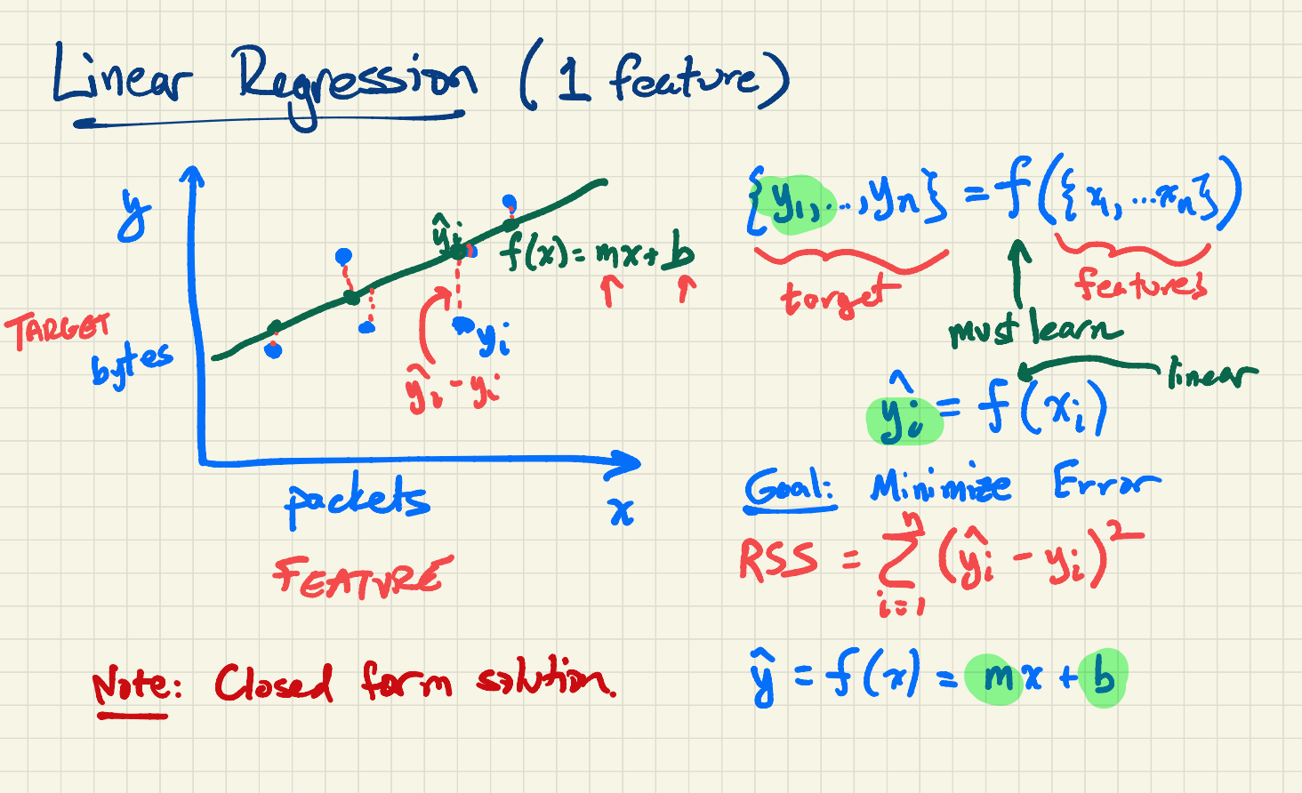

Slide 5
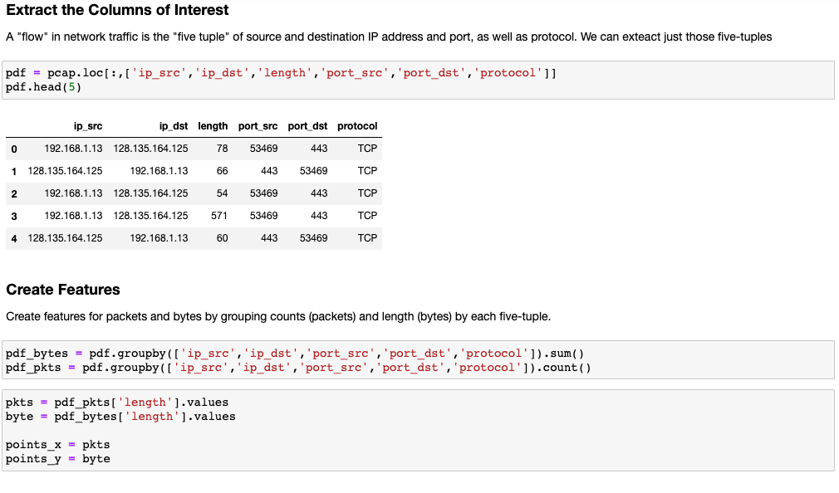

Slide 6
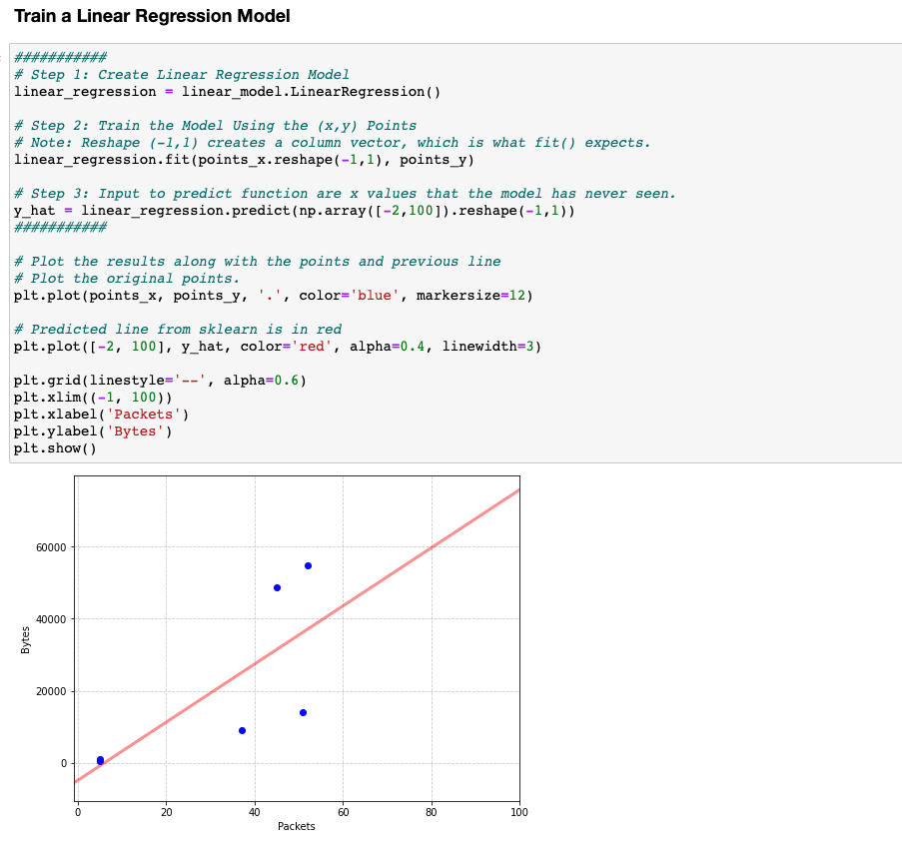

Slide 7
Logistic Regression

Slide 8
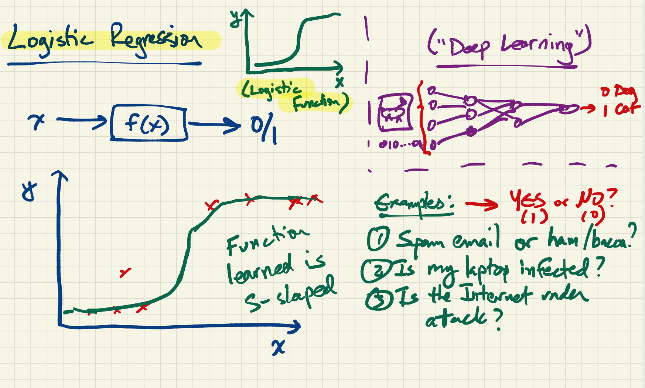

Slide 9
